Slide 1

CropMedic 2.0
A SMART PLANT DISORDER IDENTIFICATION SYSTEM

Slide 2

Research Problem
1
39.4%
Agriculture’s contribution to global GDP [1]
2
Agriculture’s contribution to global export market [1]
43%
3
42%
Agriculture production loss due to plant diseases [2]
Leading cause of plant diseases is nutrition deficiency [3]
4
5
Feasible smart solution for early detection of nutrition deficiencies recommending accurate chemical remedies

Slide 3
Overall Objectives
Nutrient Deficiency[N,P,K]
Identification for Citrus, Groundnut and Guava
Degree of Disorder Identification and Accurate Remedy Suggestion
CROP MEDIC PLUS 2.0
Soil analysis using IoT to provide
accurate degree of nutrition deficiency
Implement a distributed platform for identifying best product for deficiency based on diagnosis

Slide 4
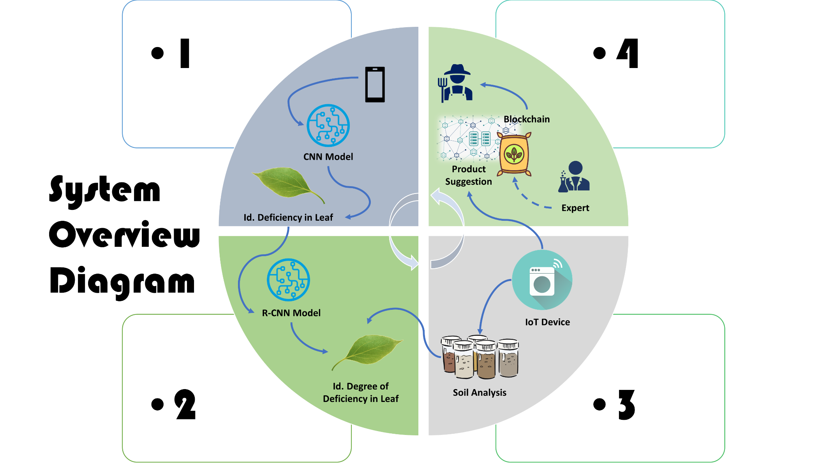

Slide 5


Component 01: Identification of nutrient disorder
IT17110808 – M.Sukanya
Specialized in Software Engineering
IT17110808 | M.Sukanya | 2020-025

Slide 6
Research Gap
Nutrition disorder
identification studies
mostly contain
satellite
image usage of entire
plots or expensive
chlorophyll meters
[1].
Mostly, Researchers
have done the research
for the identification of diseases in plant leaf.
Impractical for Field Usage and Expensive [2]
A mobile phone application that captures an image of the plant leaf and identifies the nutrient disorder
Use of Machine learning and deep learning techniques for the nutrient disorder identification
IT17110808 | M.Sukanya | 2020-025

Slide 7

7
Research Questions
01
How to identify the crop and nutrient deficiencies using image processing techniques and machine learning?
Image
Processing
Techniques
Adaptable IT
based Training
Tools
Analyzing and
find the
Best for nutrient
deficiency
identification
Machine Learning Techniques
IT17110808 | M.Sukanya | 2020-025

Slide 8
8
Objectives
Identify the Nutrient deficiency in Plants (Groundnut,
Guava, Citrus)
Main Objective
Data Collection
Image Preprocessing
01
02
Build the Machine
Learning model for
Training
Prediction of Nutrient
Disorder through the
mobile app
03
04
IT17110808 | M.Sukanya | 2020-025

Slide 9
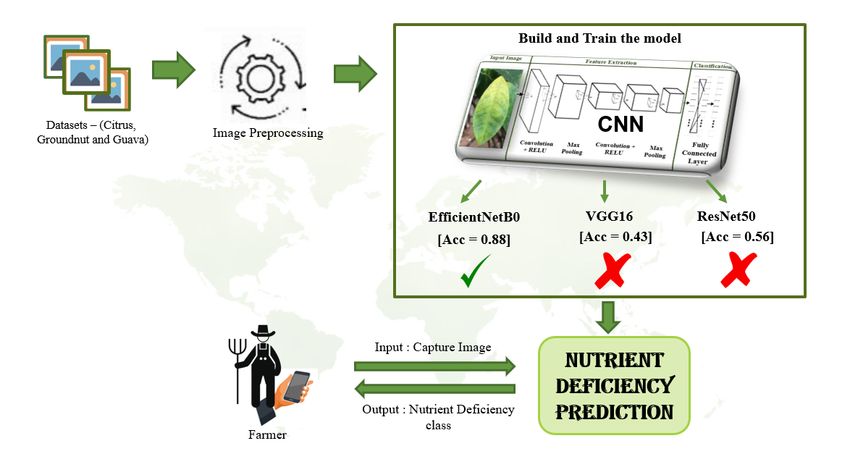
Methodology - System Diagram
IT17110808 | M.Sukanya | 2020-025

Slide 10
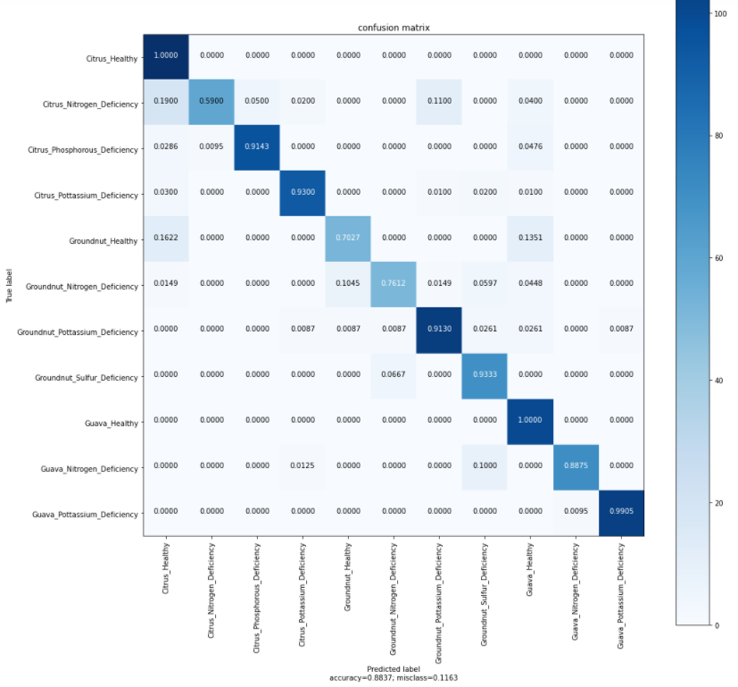

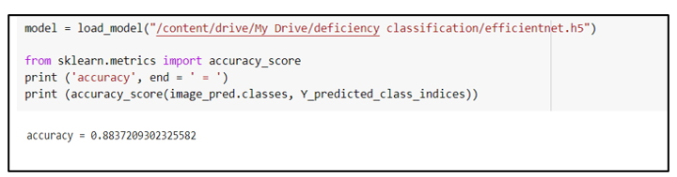
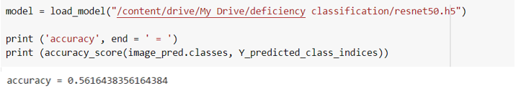
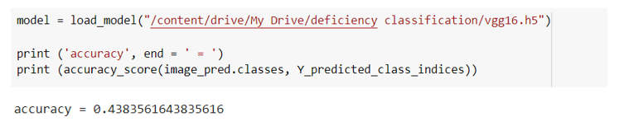
Achievement
EfficientNetB0
VGG16
ResNet50
0.8837
0.4384
0.5684
3 Models were trained – Select the Best for
the disorder identification
Acc = 0.8837

Slide 11
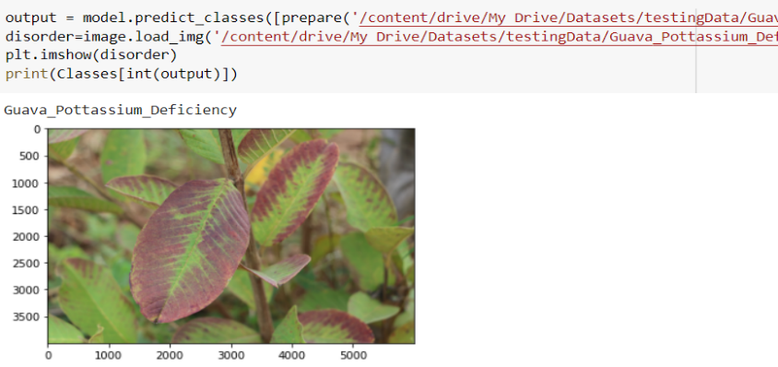
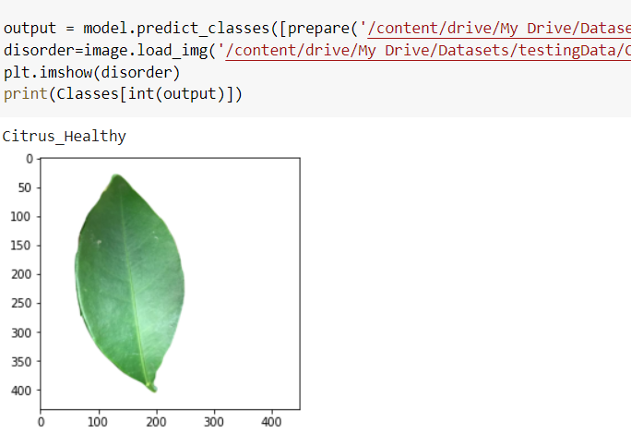
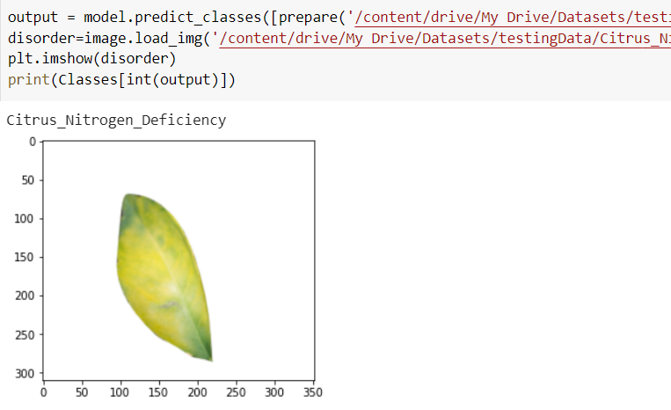
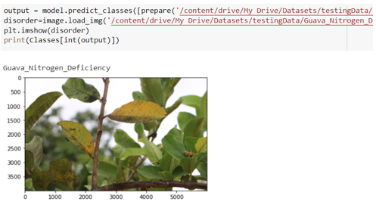
Achievement
- Results From Backend Model
IT17110808 | M.Sukanya | 2020-025

Slide 12
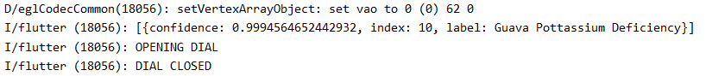
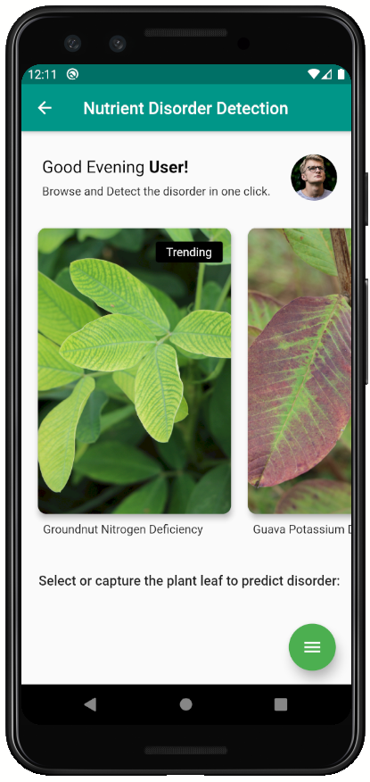
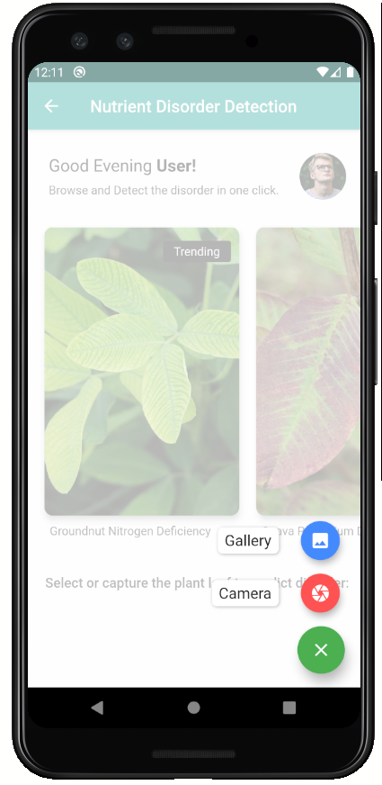
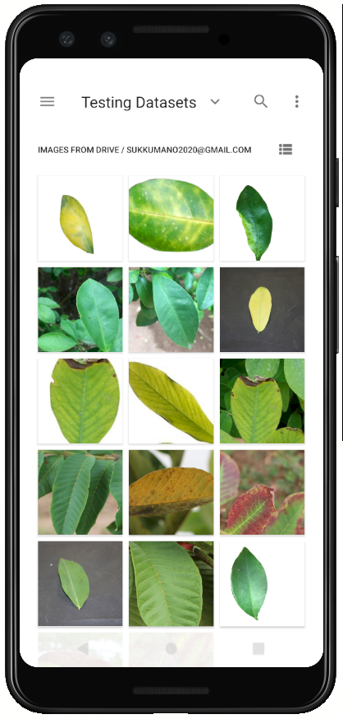
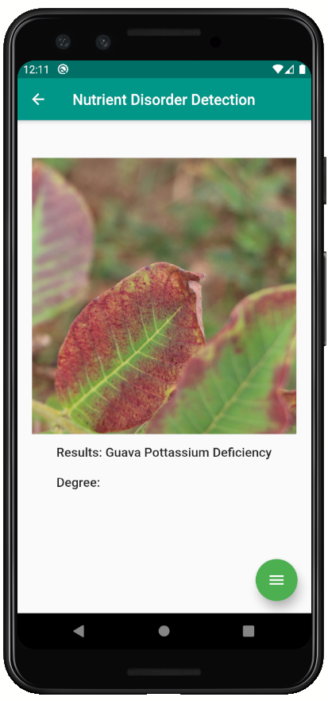
Final Prediction in mobile app
01
02
03
04

Slide 13
Reference
[1] J. G. A. Barbedo, “Detection of nutrition deficiencies in plants using proximal images and machine learning: A review,” Computers and Electronics in Agriculture, 02-May-2019. [Online]. Available: https://www.sciencedirect.com/science/article/pii/S0168169918318957. [Accessed: 15-Jan-2020].
[2] N.Minni, N.Rehna “Detection of nutrient deficiency in plants using image procssing techniques”, Department of Computer Science ,College of women Karaikkal, Puducherry, India Dong-A University, ISSN 2278-2397
[3] Sumit Saha, “A Comprehensive guide to Convolutional Neural Networks- the ELI5 way,” December 15, 2018. [Online]. Available: https://towardsdatascience.com/a-comprehensive-guide-to-convolutional-neural-networks-the-eli5-way-3bd2b1164a53 [Accessed Jan 04, 2020].

Slide 14
Demonstration

Slide 15
DISORDER DEGREE IDENTIFICATION
It17109840 – L.H.RAJARATNE
Specialized in Cyber Security
IT17109840 | L.H.RAJARATNE| 2020-025

Slide 16
Research Gap
Identify the extent of nutrition deficiency in a plant by using computer vision techniques
Using Mask RCNN to Identify the colour changes in leaves
necessary to identify the deficiency
IT17109840 | L.H.RAJARATNE| 2020-025

Slide 17
17
Research Questions
How is a nutrition deficiency measured in the field?
How can computer vision techniques be used to measure the spread of a symptom?
How to calculate the disorder degree using Mask RCNN?
IT17109840 | L.H.RAJARATNE| 2020-025

Slide 18
18
Objectives
Study the disorder degrees and its quantification
Identify the most suitable computer vision technology to use in identifying the extent of a nutrition disorder
Using mask rcnn to quantify the disorder degree
IT17109840 | L.H.RAJARATNE| 2020-025

Slide 19
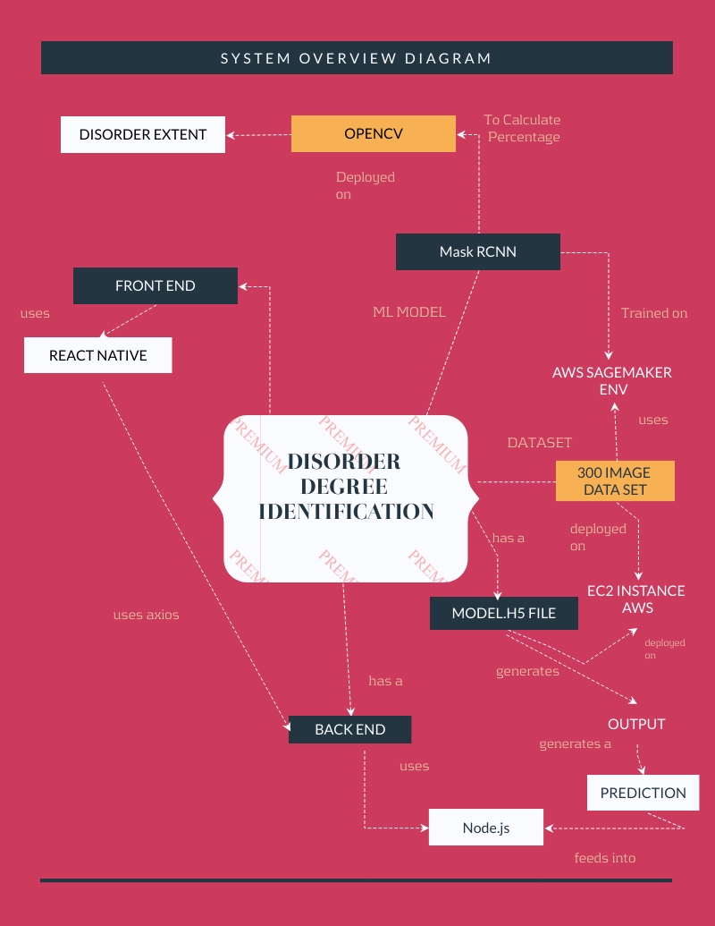
Methodology - System Diagram
IT17109840 | L.H.RAJARATNE | 2020-025

Slide 20
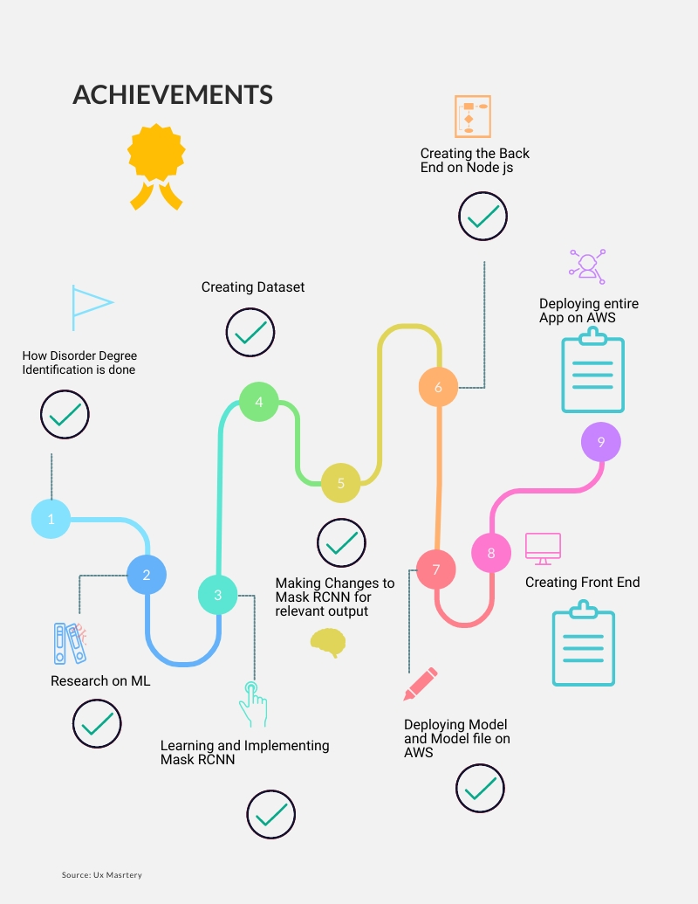
Achievement
IT17109840 | L.H.RAJARATNE| 2020-025

Slide 21
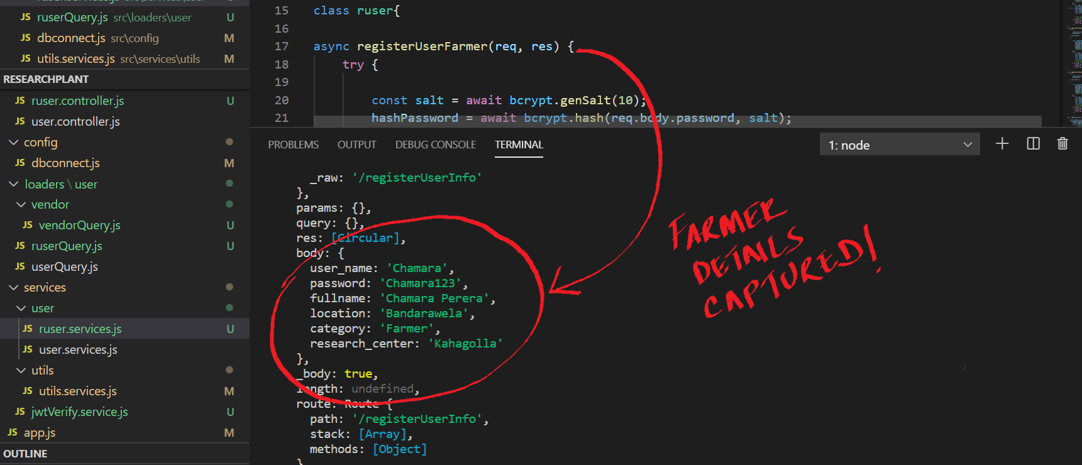
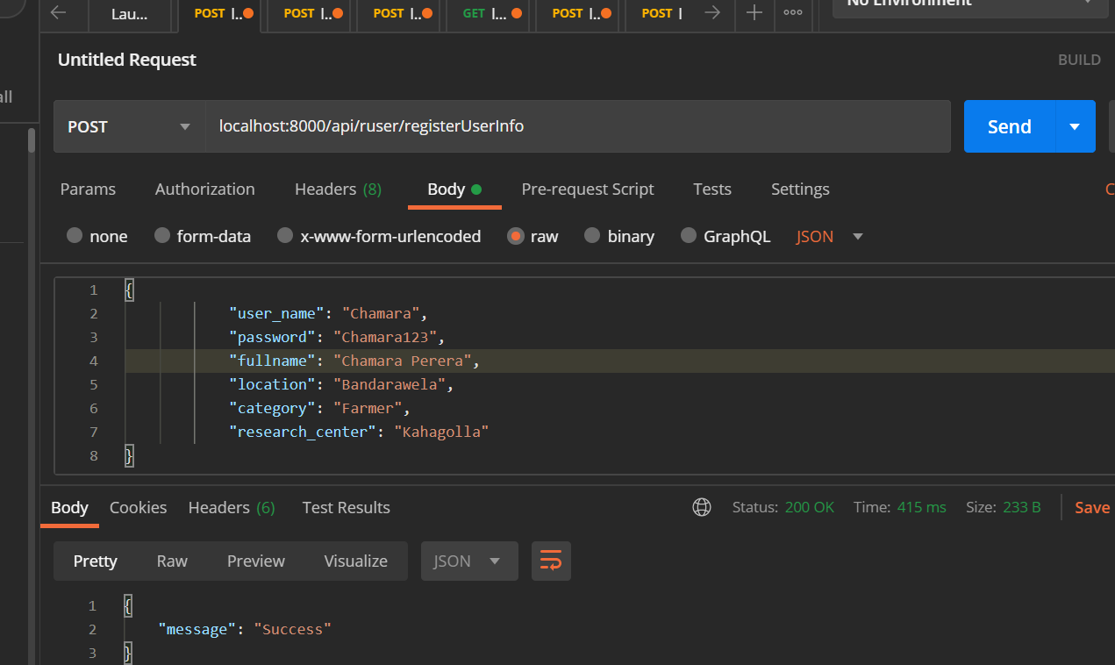
EVIDENCE
SIGNUP - CHAMARA
IT17109840 | L.H.RAJARATNE| 2020-025

Slide 22
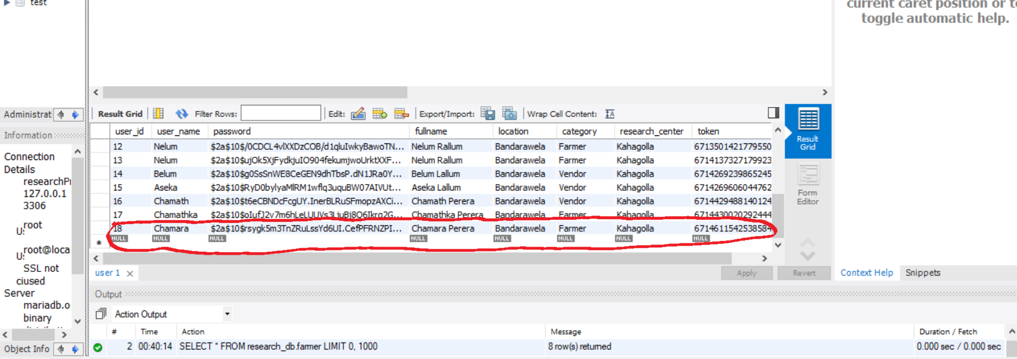
EVIDENCE
SIGNUP - CHAMARA
IT17109840 | L.H.RAJARATNE| 2020-025

Slide 23
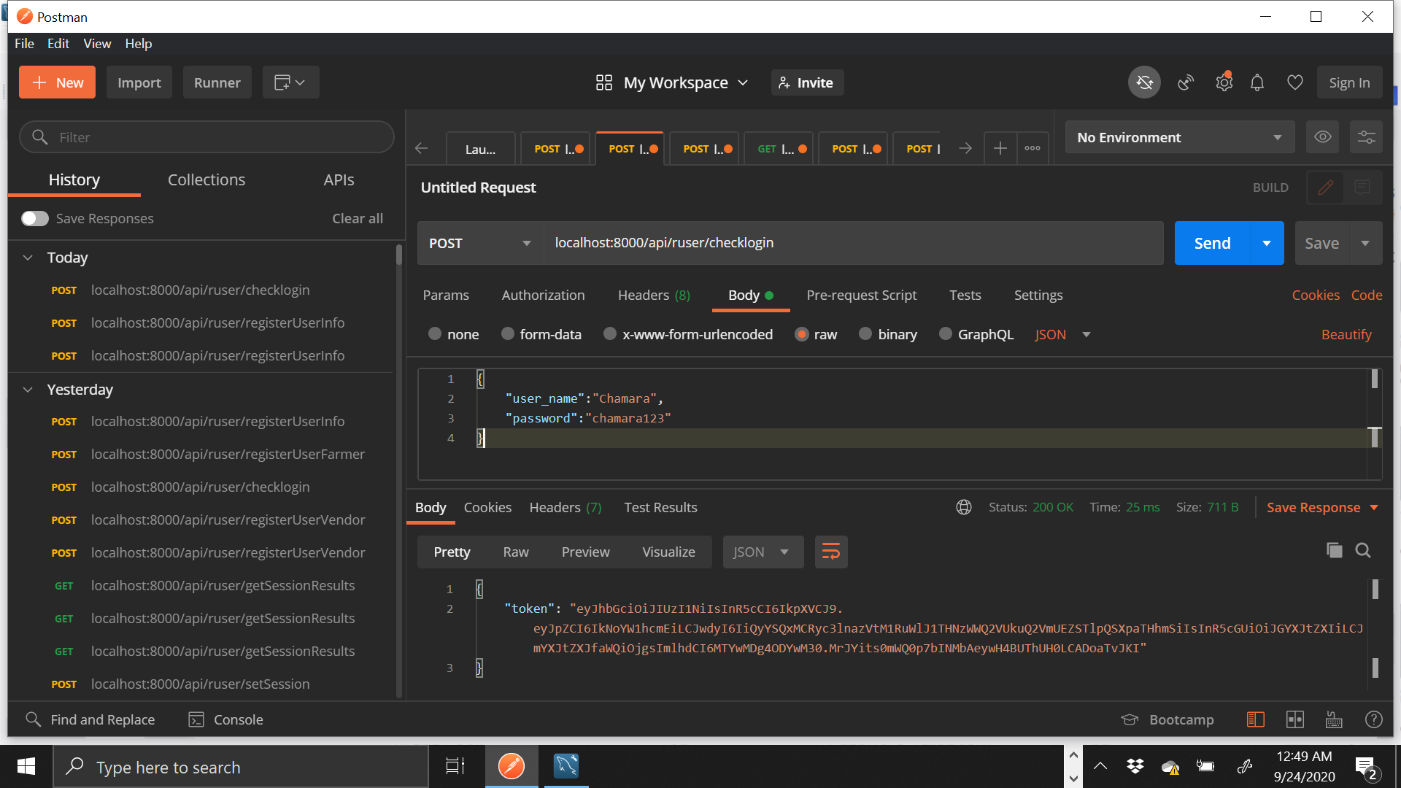
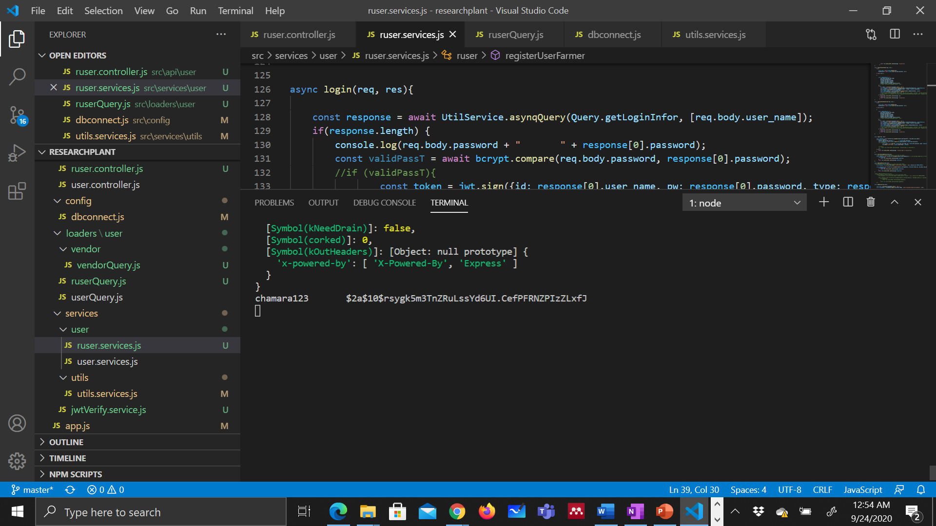

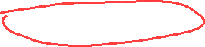
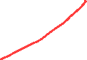
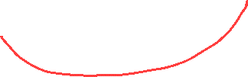

EVIDENCE
LOGIN - CHAMARA
IT17109840 | L.H.RAJARATNE| 2020-025

Slide 24
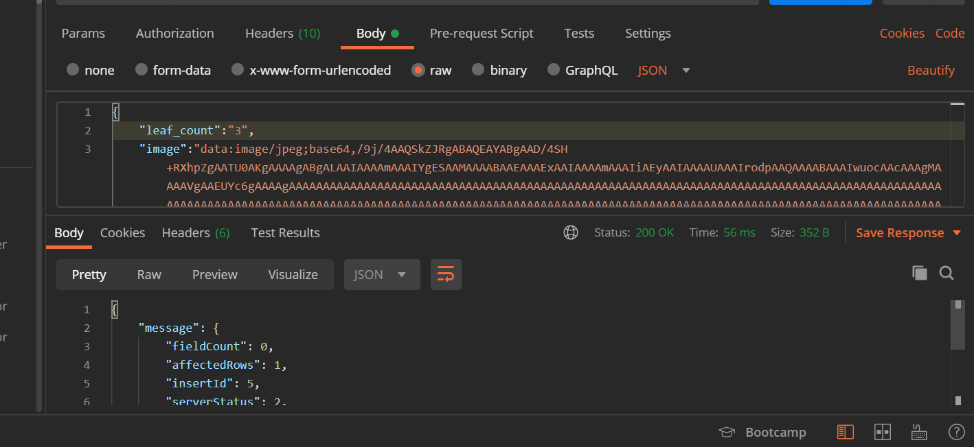
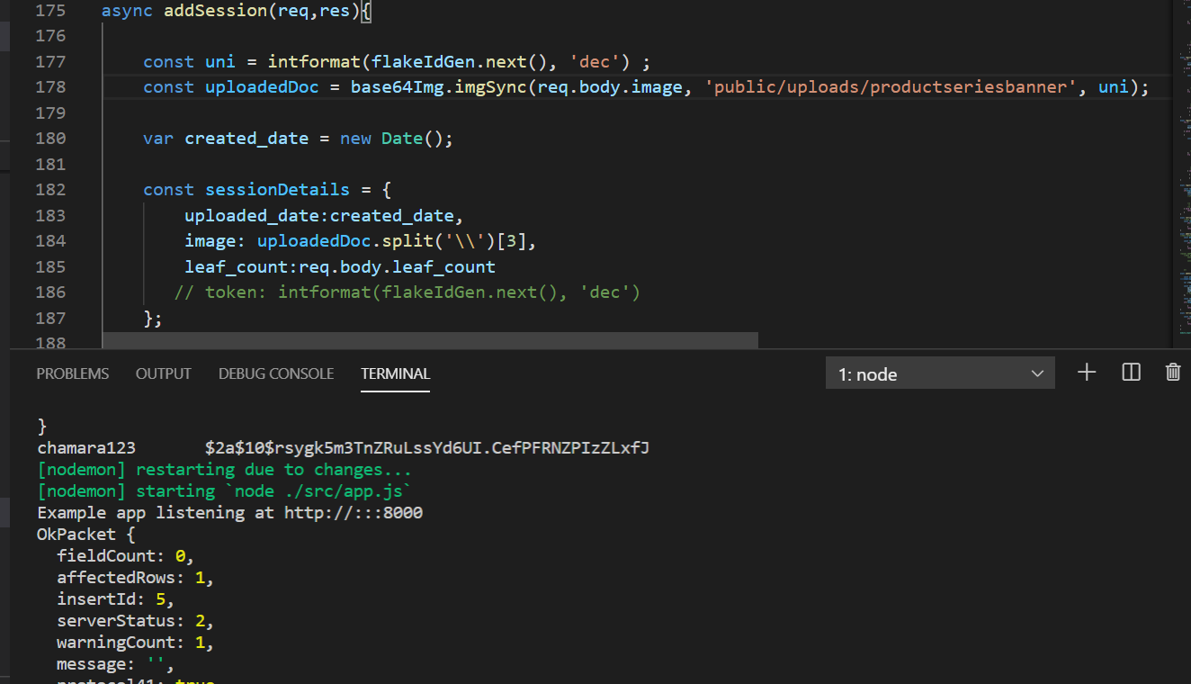


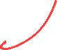
EVIDENCE
ADDING SESSION
IT17109840 | L.H.RAJARATNE| 2020-025

Slide 25
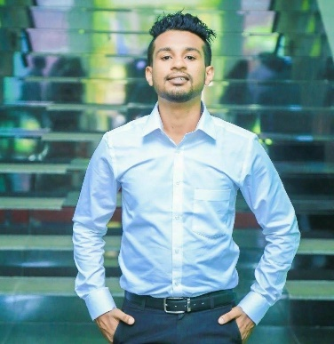
Component 02: Develop an IOT device to measure
NPK level of soil
IT15070418- K.T.Ramasinghe
Specialized in Cyber Security
IT15070418| K.T.Ramasinghe | 2020-025

Slide 26
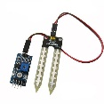
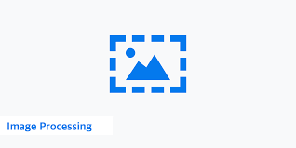

Research Gap
Almost all the projects were carried out by doing laboratory tests with using various chemicals or using expensive sensors to check the nutrient levels in the soil.
Sensors to test the nutrient factors of the soil will lead to spend the user a lot of money
using image processing techniques and data mining techniques, need specific people who has specialized in the area of image processing or the chemists who needs to perform the lab tests according to the soil samples
Farmers satisfactions
IT15070418 | K.T. Ramasinghe| 2020-025

Slide 27
27
Research Questions
Farmers have lack of knowledge about soil nutrient levels.
Farmers need to test soil samples with the help of agriculture department.
Variety of soil nutrient levels in same land.
Farmers use same soil test report for 1.5 years.
Maintaining cost of industrial machines is expensive.
The fear of new cultivators to entering the industry
IT15070418 | K.T.Ramasinghe| 2020-025

Slide 28
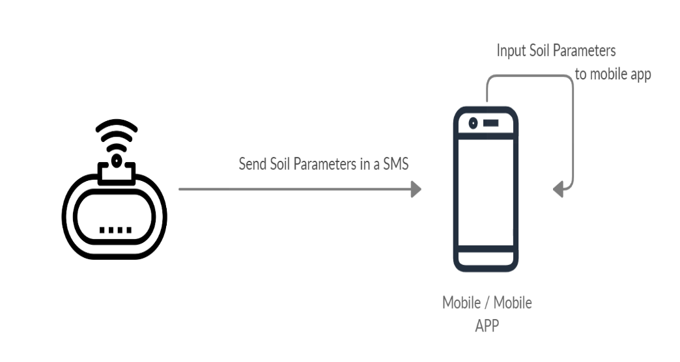
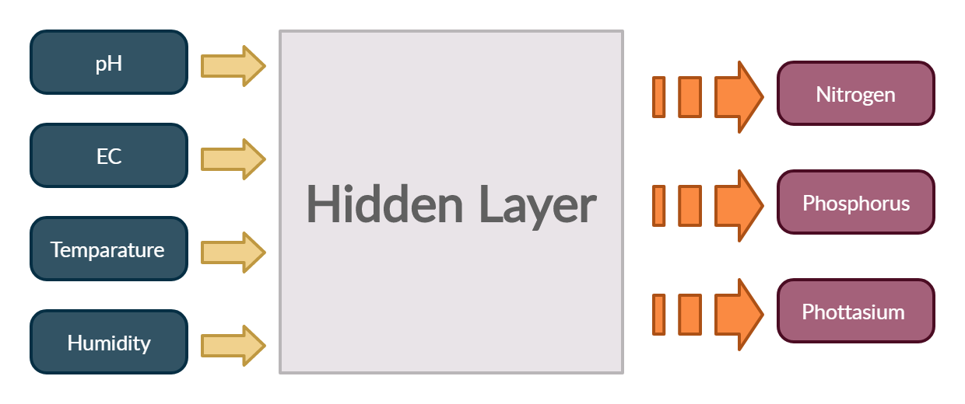
Methodology - System Diagram
IT15070418 | K.T.Ramasinghe | 2020-025

Slide 29
objectives
To identify soil status when plant disorder is detected.
To change nutrient level in soil according to crop we need to grow. So, can gain good result.
To provide a basis for fertilizer recommendation for a given crop.
Save the soil by applying the accurate amount of fertilizer
To use by any person to start their own plantation.
To reduce the risk of not being able to have good result from plantations.
IT15070418 | K.T.Ramasinghe| 2020-025

Slide 30
Achievement
01
Constructing user friendly consumer device to measure NPK level of soil.
02
Being a motivational fact for farmers to do more
Cultivations.
03
Proposing and constructing a successful system
To protect soil contamination.
IT15070418 | K.T.Ramasinghe | 2020-025

Slide 31
Demonstration
IT15070418 | K.T.Ramasinghe | 2020-025

Slide 32
Component 04: Decentralized System for
Fertilizer Procurement
IT17354516 – B. I Sariffodeen
Specialized in Cyber Security
IT17354516 | B. I. Sariffodeen | 2020-025

Slide 33
Research Gap
Sri Lankan authorities have backed an approach toward e-agriculture, utilizing ‘Smart Farming’ for sustainable practices. Practical infeasibilities of this approach are abundant
Most Systems constructed for information management are centralized which enhances risk, and are trust driven, relying on the Human Trust Factor for verification
While the environmental effects of Fertilizer Mismanagement are widely discussed, the social sensitivity of this matter is given less prominence. The social sensitivity arguably has the greatest impact on fertilizer procurement.
IT17354516 | B. I. Sariffodeen | 2020-025

Slide 34
34
Research Questions
01
How feasible would a solution integrating farmers, field experts and vendors be?
What are the factors to be considered when constructing a system interlinking stakeholders?
02
How is it possible for proposed system to lift asymmetry of information?
What information should be provided by expert in-order-to help farmer make well-informed decision?
03
How can securely transmissions occur between farmers and experts while maintaining transparency of vendor transactions?
What methodology would provide a decentralized, secure and transparent platform for this purpose?
IT17354516 | B. I. Sariffodeen | 2020-025

Slide 35
35
Objectives
Streamline Fertilizer Procurement using a decentralized approach
Enhance Information access for farmers
Utilize Expert Knowledge Effectively
Lift information asymmetry lift bias toward vendor
Generate better Fertilization practices and conserve soil constitution
IT17354516 | B. I. Sariffodeen | 2020-025

Slide 36
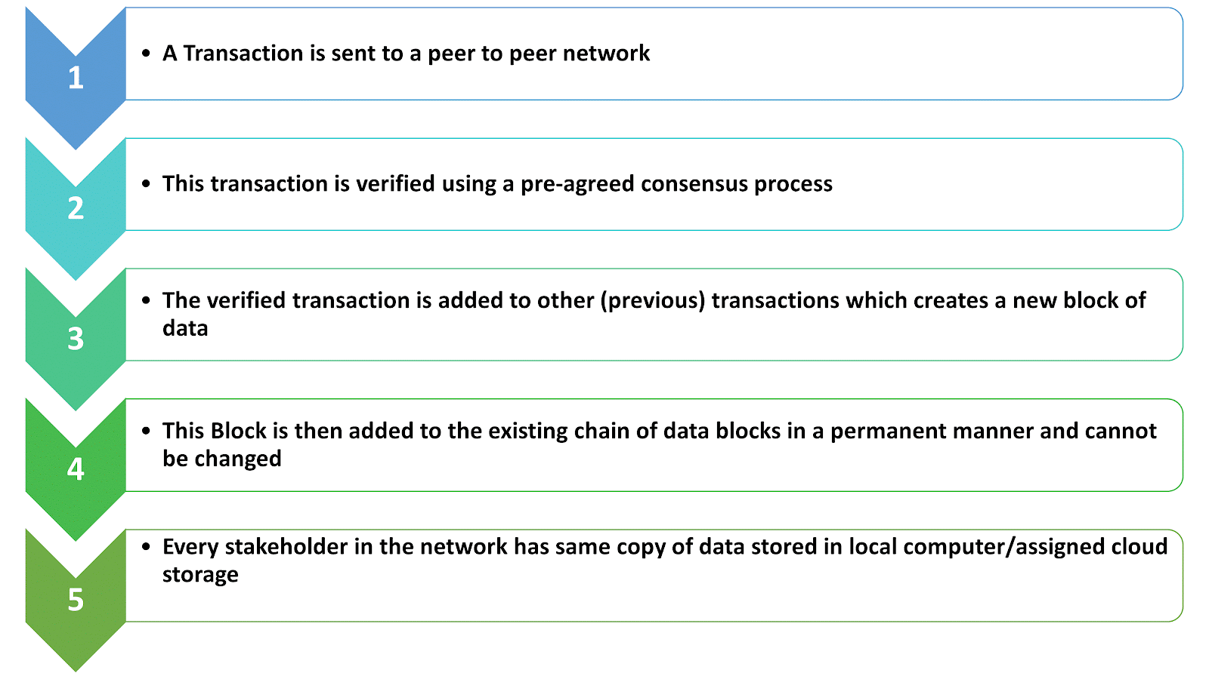
36
Blockchain workflow: Understand Why Blockchain
IT17354516 | B. I. Sariffodeen | 2020-025

Slide 37
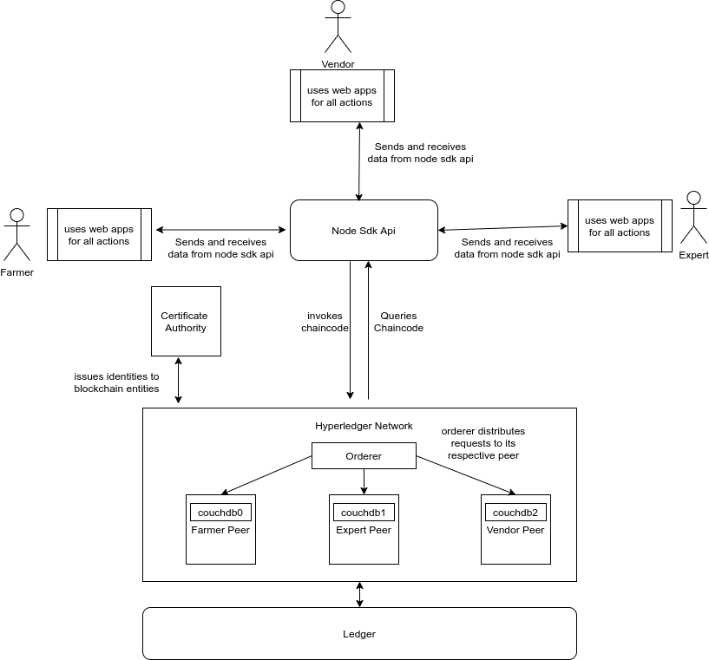
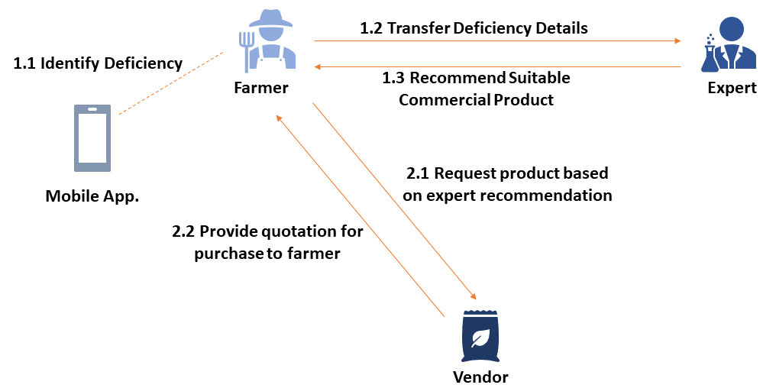
Methodology - System Diagram
IT17354516 | B. I. Sariffodeen | 2020-025

Slide 38
Achievement
01
Constructing a decentralized ledger based system to replicate the existing trust-driven centralized system
02
Enabling better information access to farmers, enabling RAS in compliance to MDGs
03
Proposing and constructing a successful system to lift bias toward intermediaries in a purchasing ecosystem
IT17354516 | B. I. Sariffodeen | 2020-025

Slide 39
Demonstration

